Slide 1
NORTHSTAR INTELLIGENCE PLATFORM
Attribution Lab
Visual logic & calculations
Six models, one set of journeys, six different answers about which vendors
earned the budget. This is how the page decides between them.
Selected: Last Touch · recommended: First Touch · captured July 2026

Slide 2
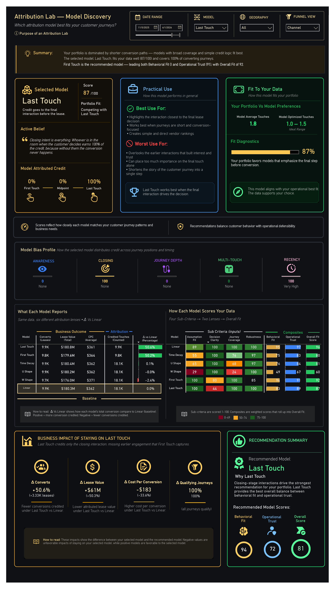
Model Discovery
Does the model you picked actually fit the journeys you have?

Slide 3
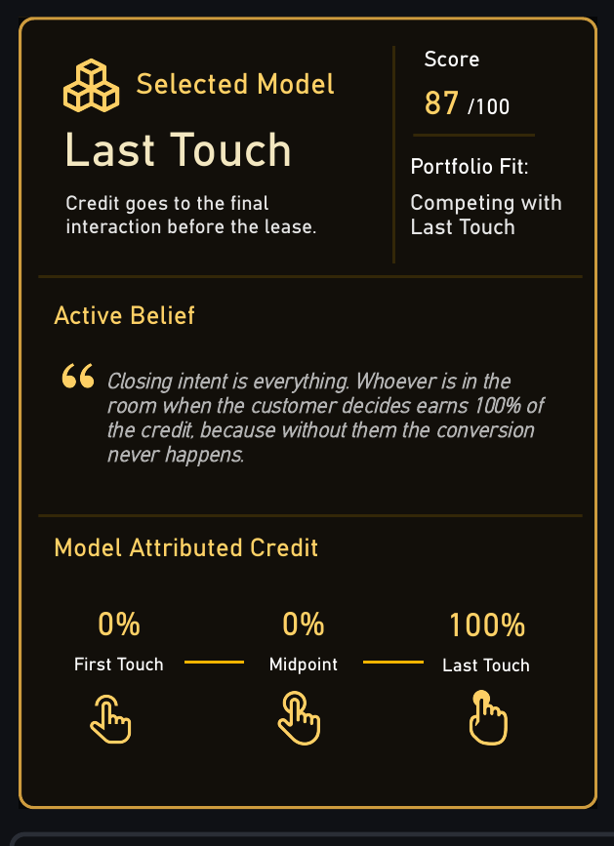
1 · Selected Model
A credit rule is a claim about how leasing works
LAST TOUCH — CREDIT DISTRIBUTION
First Touch 0%
Midpoint 0%
Last Touch 100%
Six models, six rules. Same journeys, divided differently.
The belief underneath
Last Touch asserts that closing intent is everything — whoever is present at the decision earns all of it. That is a defensible position, and it is also a position, not a measurement.
The 87 is Overall Fit against this portfolio, not a quality rating of the model. A model can be sound in general and still be the wrong lens for the journeys you actually have, which is the distinction the rest of the page exists to draw.

Slide 4
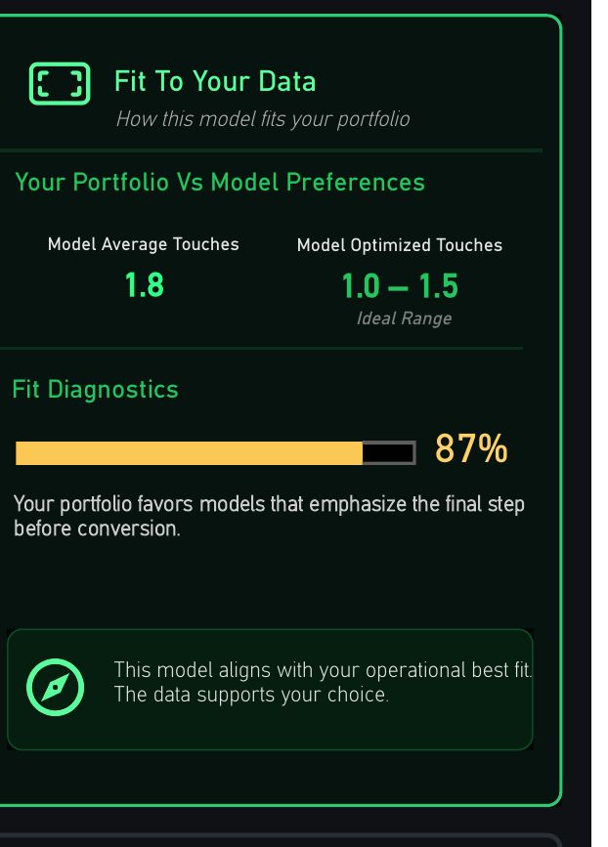
2 · Fit To Your Data
Journey shape, measured against what the model assumes
ASSUMPTION FIT — PENALTY LADDER
avg touches ≤ 2 penalty 0
≤ 4 penalty 5 + (t-2) × 7.5
≤ 7 penalty 20 + (t-4) × 5
≤ 12 penalty 35 + (t-7) × 5
>12 penalty 60
score = MAX(0, 100 - penalty)
At 1.8 average touches Last Touch draws no penalty. Assumption Fit 100.
Every model has an enemy
1.8 against an ideal of 1.0–1.5
The ladder differs by model. Last Touch is punished by long journeys with real pre-close work; First Touch by long elapsed time, and again if journeys are so short that first and last are the same touch.
Short paths are why single-touch models score well here.
On a portfolio with six-touch journeys the same models would collapse, and nothing about the models would have changed.

Slide 5
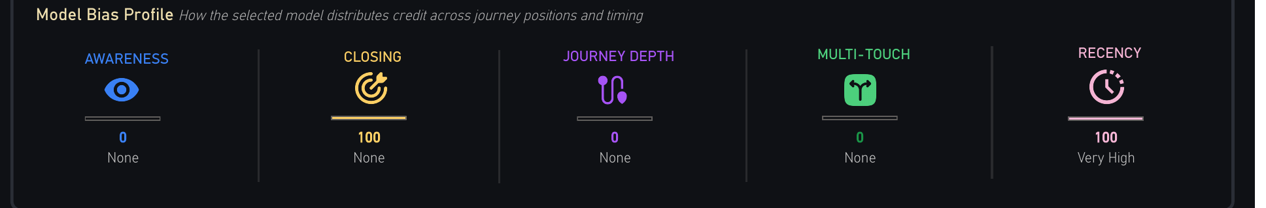
3 · Model Bias Profile
Five fixed dimensions declaring what the rule over-weights
BIAS — CLOSING, BY MODEL
Declaring bias up front
First Touch 0
W Shape 30
Linear 33
U Shape 40
Time Decay 50
Last Touch 100
Every attribution model is biased. The dishonest ones just don't say so.
Last Touch reads Closing 100, Recency 100, and zero on Awareness, Journey Depth and Multi-Touch. That profile isn't a defect to correct — it is the model doing precisely what it was chosen to do.
Stating it here means a vendor ranking can be argued with on the rule rather than on the arithmetic. Which is the argument you want to be having.
Constants. A property of the model, never of the data.

Slide 6
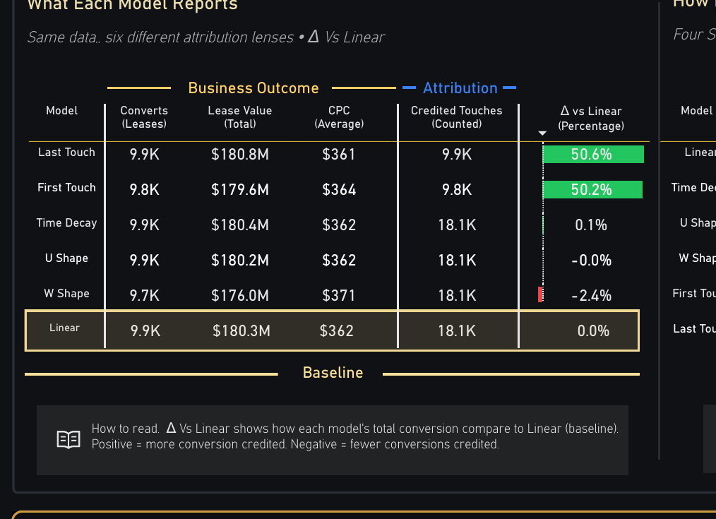
4 · What Each Model Reports
The same journeys under six lenses, every difference indexed to Linear
What the table is showing
—
Single-touch models credit one touch per journey — First Touch 9.8K, Last Touch 9.9K. The four multi-touch models credit every touch, at 18.1K each.
—
Lease value lands between $176.0M and $180.8M across all six. A spread under 3%.
—
That is the finding. Attribution does not change how many leases were signed or what they were worth; it changes only who gets credited for them.
—
Which makes the model choice a budget-allocation decision wearing the costume of a measurement one.

Slide 7
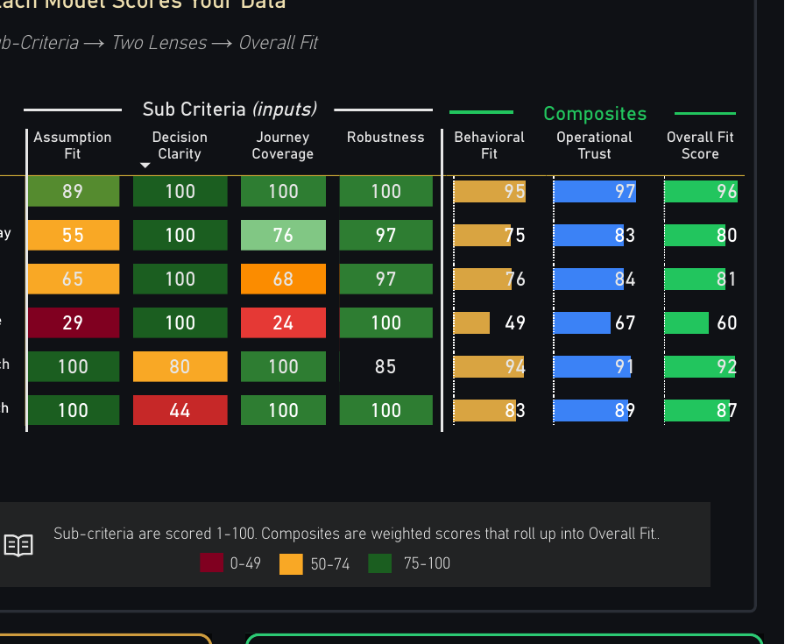
5 · How Each Model Scores Your Data
Four sub-criteria, two lenses, one Overall Fit
THE TWO LENSES
Behavioral Fit = 0.40 × Assumption Fit
+ 0.30 × Journey Coverage
+ 0.30 × Decision Clarity
Operational Trust = 0.25 × Assumption Fit
+ 0.20 × Journey Coverage
+ 0.20 × Decision Clarity
+ 0.35 × Robustness
Robustness enters Trust only. Stability is an operational question, not a behavioural one.
WORKED ON FIRST TOUCH
A 100 C 100 D 80 R 85
BF = 0.40(100) + 0.30(100) + 0.30(80) = 94.00
OT = 0.25(100) + 0.20(100) + 0.20(80)
+ 0.35(85) = 90.75
Overall = 0.40(94.00) + 0.60(90.75) = 92.05
Trust outweighs Fit 60/40 — a defensible answer beats a flattering one.

Slide 8
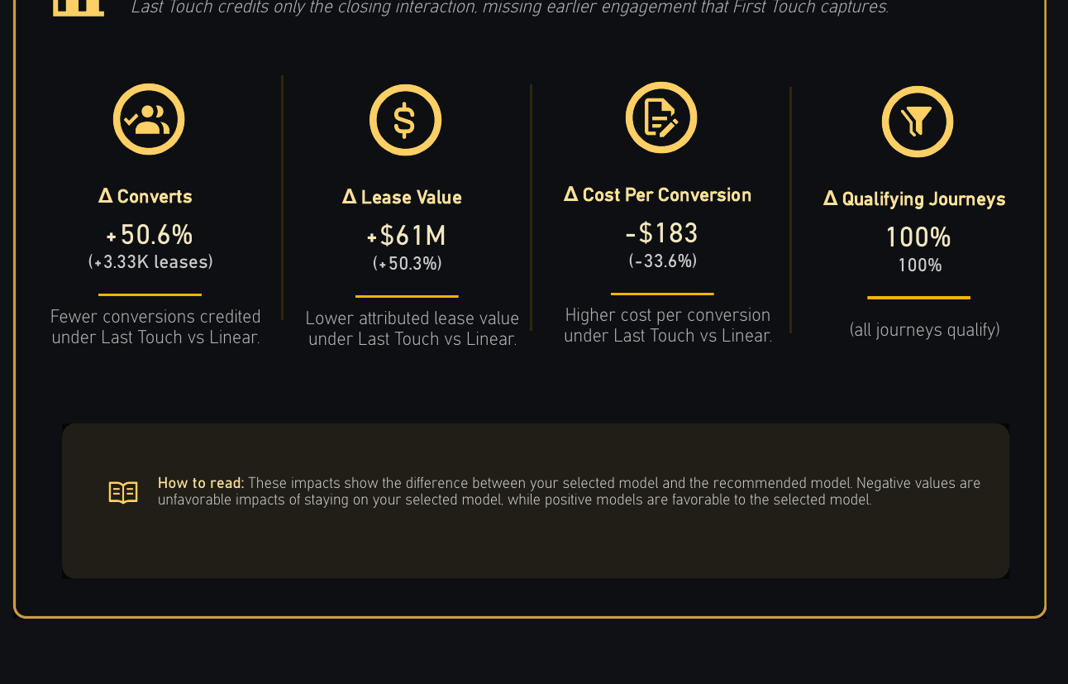
6 · Business Impact
What staying on the selected model costs, in leases and dollars
THE FOUR DELTAS
Δ Converts +50.6%
Δ Lease Value +$61M
Δ Cost / Conv -$183
Δ Qualifying 100%
Selected model against the recommended one.
Stated in money on purpose
87 against 92 is an abstraction. $61M in attributed lease value is not.
This section exists to turn a methodological preference into a number a budget owner can push back on.

Slide 9
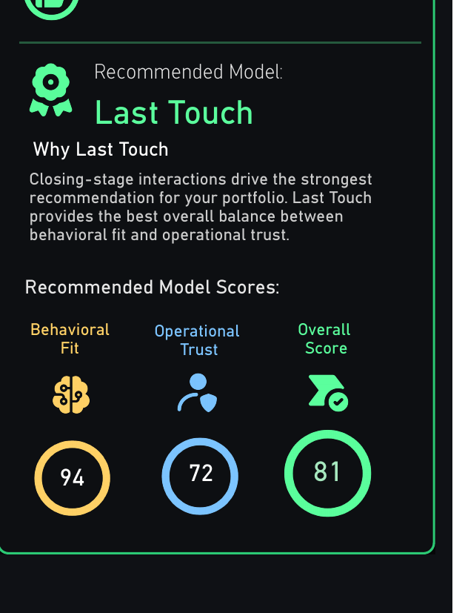
7 · Recommendation Summary
One model named, by the highest Overall Fit
Selection is mechanical. What happens next is not.
Linear 96, First Touch 92, Last Touch 87, U Shape 81, Time Decay 80, W Shape 60. The recommendation is TOPN over those six scores, descending. Highest wins outright.
No weighting by preference, no manual override, no tie-breaking rule that could be tuned after the fact to produce a preferred answer.
And then it stops. The page names a model, reports the gap, and prices the difference — but it does not switch anything.
Attribution is a commercial agreement about how vendors get paid at least as much as it is a measurement choice. So the page hands the operator a defensible position rather than a decision already taken on their behalf.

Slide 10
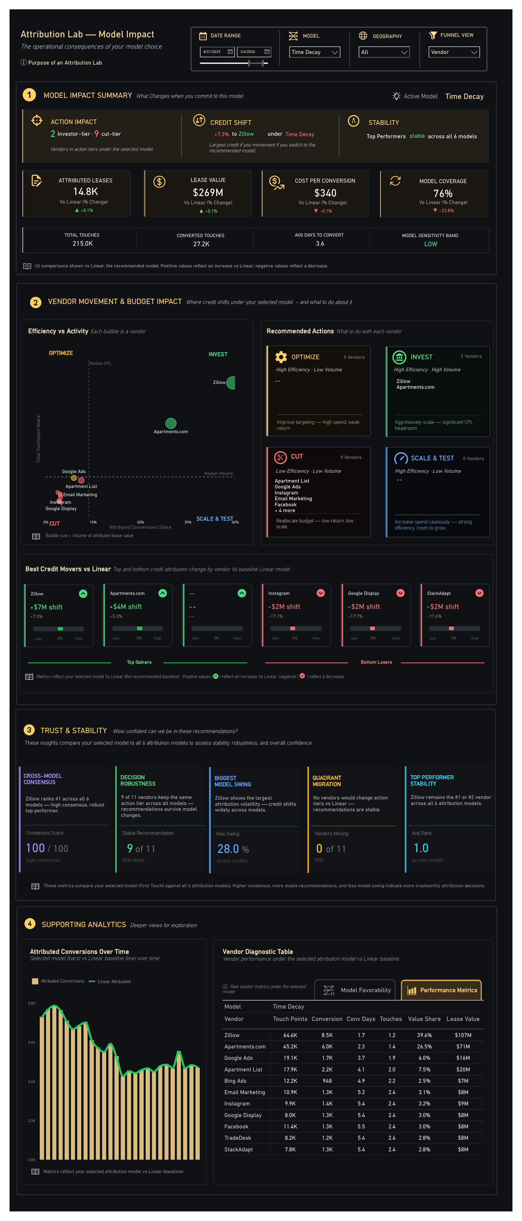
Model Impact
If you commit to this model, what actually changes?

Slide 11
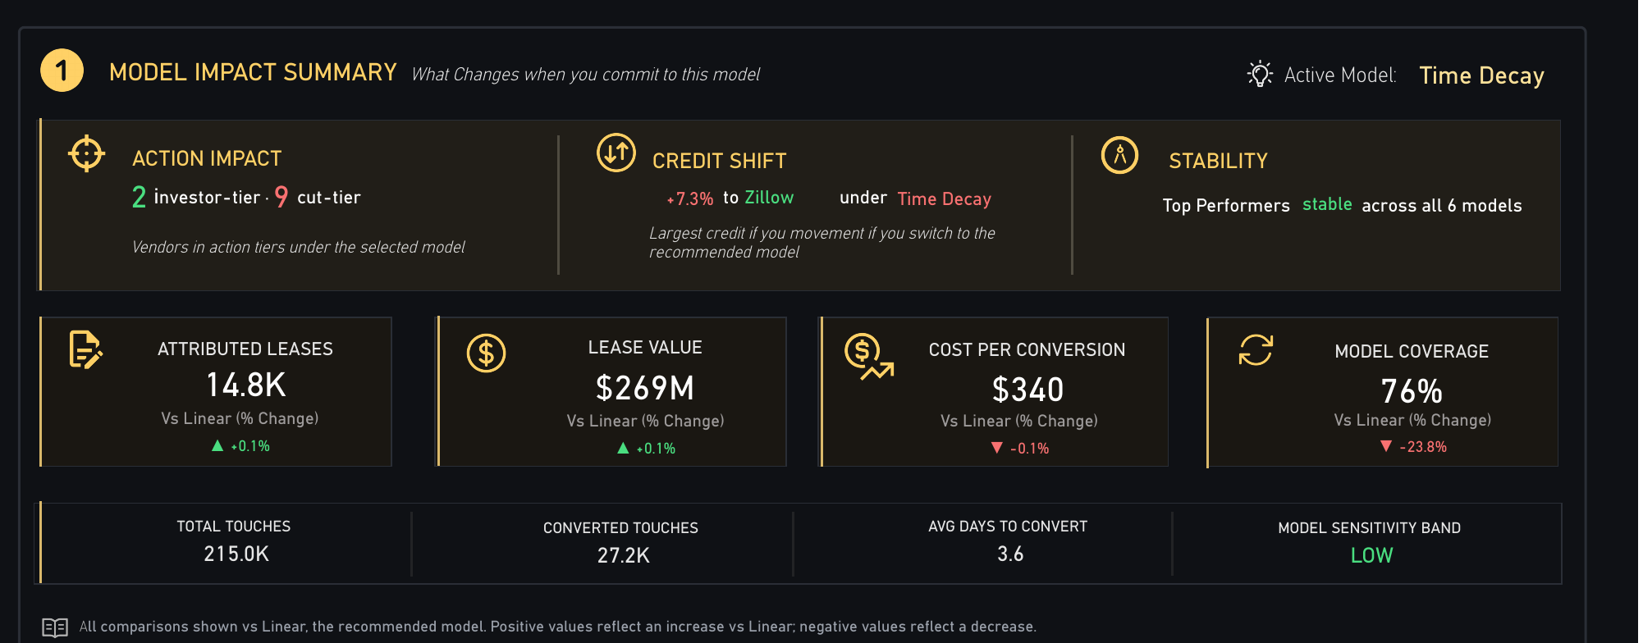
8 · Model Impact Summary
One number is doing all the work
ALL FIGURES VS LINEAR
The asymmetry is the finding
Attributed Leases 14.8K ▲ +0.1%
Lease Value $269M ▲ +0.1%
Cost per Conversion $340 ▼ -0.1%
Model Coverage 76% ▼ -23.8%
Three headline figures move by a tenth of a percent. Coverage falls 23.8%.
Switching models barely alters the totals. What it changes is which journeys are eligible to be counted — and therefore which vendors can be paid.
A health score averaging these four together would have buried exactly the thing worth knowing.
Coverage = share of converting journeys the model can credit at all.

Slide 12
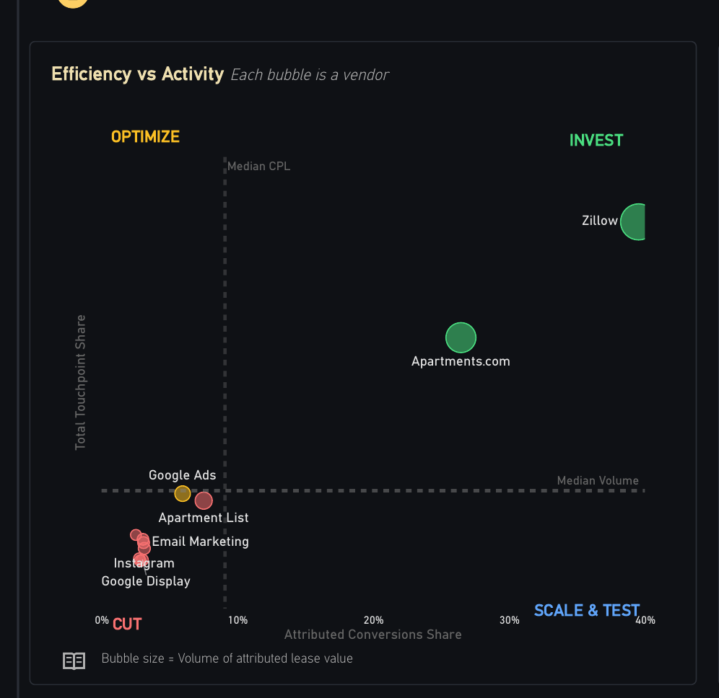
9 · Vendor Movement
Two shares against a fair-share line, one posture per vendor
QUADRANT ASSIGNMENT
conv > fair and touch > fair → INVEST
conv ≤ fair and touch > fair → OPTIMIZE
conv ≤ fair and touch ≤ fair → CUT
conv > fair and touch ≤ fair → SCALE & TEST
conv = share of attributed conversions
touch = share of contributed touchpoints
Two comparisons, one line. No thresholds to tune.
Share, not volume
A vendor is judged on whether it converts more than its share of the touches it consumes. So a large vendor cannot spend its way into a good quadrant.
Zillow and Apartments.com clear the line on both axes. Nine vendors clear neither.

Slide 13
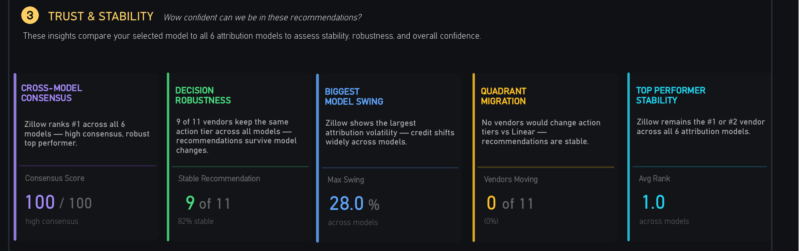
10 · Trust & Stability
Would the recommendation survive changing the model?
Five tests, run across all six models
—
Consensus — wins divided by six, times 100. Scores 100.
—
Robustness — vendors holding their action tier. 9 of 11.
—
Max swing — widest credit shift across models. 28.0%.
—
Migration — vendors changing tier against Linear. 0 of 11.
—
Average rank — top vendor across all models. 1.0.
—
—
Every other section reports what the selected model says. This one asks whether that answer is an artefact of having selected it. Nine of eleven vendors hold tier and nothing migrates, so it isn't.
—
Where consensus runs low, the honest move is to act on the vendors all six models agree about and leave the rest alone.

Slide 14
What the page decides for you
Six behaviours, each governed by fixed and auditable rules
01
02
03
Declares its own bias
Tests the model against your journeys
Separates fit from trust
Five fixed dimensions, stated before any vendor is ranked
A penalty ladder on average touches and elapsed days, with a different enemy for every model. This is the step most attribution tooling skips entirely
Behavioural plausibility and operational defensibility scored apart, then weighted 40/60
04
05
06
Names one model and prices the gap
Checks its own stability
Stops short of switching
Highest Overall Fit wins outright, and the difference is restated in leases and dollars
Five tests re-run the recommendation across all six models
A defensible position, handed over. The commercial decision stays with the operator
The models disagree by design. The page measures the disagreement rather than quietly resolving it.

Slide 15
NORTHSTAR INTELLIGENCE PLATFORM
The model is a choice.
The page prices it.
Attribution Lab · Visual logic & calculations

